Slide 1
Assignment 3 : MIMIC NLP
https://github.com/coursegit24/MSAI_AIH_MIMICNLP_NN
Feb 20, 2025 Submission by Nalin Nishant - nn8989

Slide 2
Objective
Extract clinical entities from MIMIC dataset using Natural Language Processing (NLP)
Apply dimensionality reduction using t-SNE for visualization
Generate insights from clinical text data through entity clustering

Slide 3
Approach and Methodology
1. Data Preprocessing:
Load and clean clinical text data from the MIMIC dataset.
Handle missing values and standardize text formats.
2. NLP Pipeline:
Use spaCy and ClinicalBERT for entity extraction.
Identify and categorize clinical terms (e.g., diseases, medications).
3. Dimensionality Reduction with t-SNE:
Transform high-dimensional word embeddings to 2D space.
Visualize clusters of related clinical terms.
4. Visualization and Analysis:
Generate scatter plots to observe patterns and insights.

Slide 4
Details…
1.Setup and Initialization (Google colab)
Library Installations: Installing scispacy, medspacy, spacy, nltk, and transformers for NLP and visualization (matplotlib, seaborn).
2. Data Loading and Preprocessing
DIAGNOSES_ICD.csv.gz: Extracts patients diagnosed with '430' (Subarachnoid Hemorrhage).
NOTEEVENTS.csv.gz: Filters 'Discharge summary' notes for the identified patients.
3. Model Loading and NLP Pipeline
spaCy General Model: en_core_web_sm.
scispacy Scientific Model: en_core_sci_sm.
medspacy Medical Model.
ClinicalBERT: For advanced medical entity extraction.
4. Entity Extraction
Functionality: extract_entities_with_nlp function to extract entities using any NLP model.
Displays first 5 entities extracted by each mode
5. Embedding and Visualization
Word2Vec Model:
Tokenizes discharge summary texts and trains word.
t-SNE Visualization:
Reduces dimensionality of word vectors to 2D & visualizes embeddings using a scatter plot
6. Output and File Handling:
Entity extraction results saved as nlp_entities.txt.
t-SNE data saved as tsne_transformed_words.csv.

Slide 5
Output
Clinical Entity Extraction (nlp_entities.txt):
Key Categories:
Medical Diagnoses: Conditions such as melanoma, sepsis, atrial fibrillation, and stroke.
Procedures & Tests: Interventions like resection, craniotomy, EEG, CTA, and ECHO.
Medications: Pharmaceuticals including Dilantin, Keppra, diltiazem, metoprolol, and morphine.
Clinical Observations: Findings such as seizures, aphasia, edema, and hemorrhage.
Patient History: Details on social and medical backgrounds, including smoking habits, hypertension, and lung cancer.
Semantic Mapping & Visualization (tsne_transformed_words .csv):
Key Highlights:
Dimensionality Reduction: Condenses high-dimensional data into a two-dimensional representation for clarity.
Cluster Identification: Reveals groupings of related terms, illustrating connections among medications, diagnoses, and clinical observations.
Contextual Insights: Maps the proximity of terms, offering a deeper understanding of their interrelations and contextual significance.
Data-Driven Visualization: Facilitates intuitive comprehension of clinical term associations through spatial representation.

Slide 6
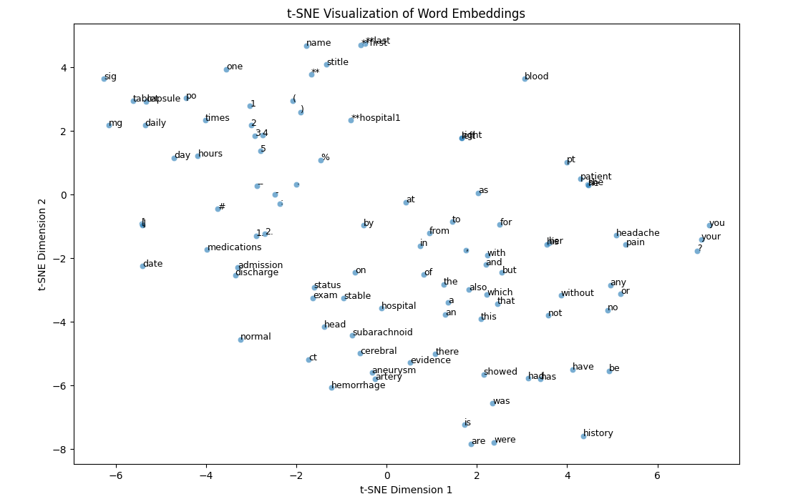
Output plot

Slide 7
Thank You

